Slide 1
Cloud computing
Presented by,
M.KARUPPASAMY

Slide 2

Cloud Computing: The Future of IT Infrastructure
Welcome! Today, we'll explore cloud computing. Discover its impact on IT infrastructure.
From cost savings to scalability, the cloud offers many benefits. We will discuss security and real-world examples.

Slide 3
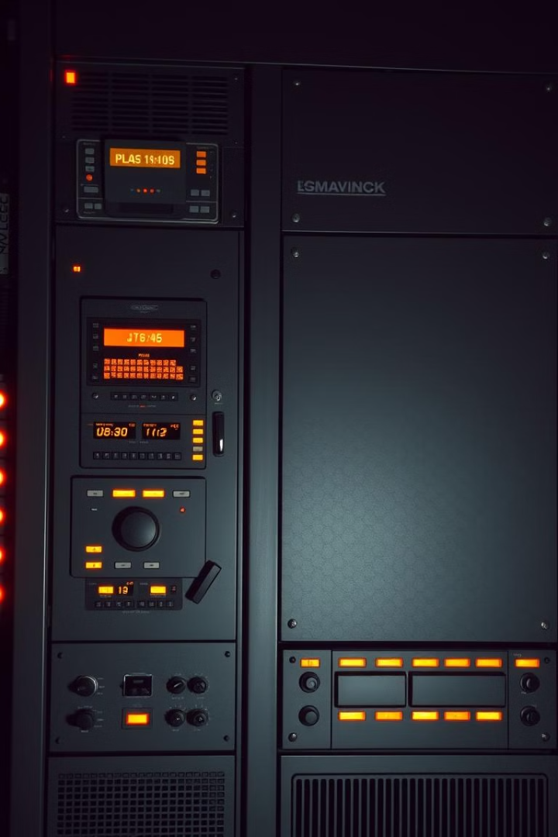
History of Cloud Computing
1
1960s: Mainframe Era
Time-sharing systems lay groundwork for resource sharing.
2
1990s: Virtualization
VMware and others bring server virtualization to the masses.
3
2000s: AWS Launches
Amazon Web Services pioneers cloud services.
4
Present: Cloud Dominance
Cloud platforms are now an essential part of IT.

Slide 4
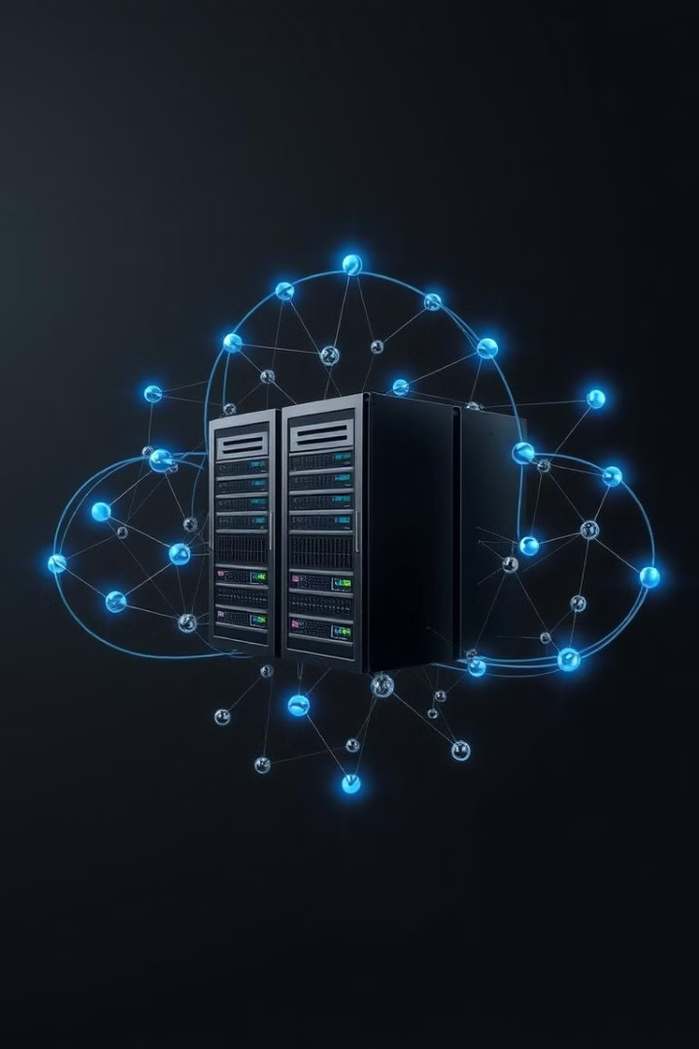
What is Cloud Computing?
On-Demand
Access resources as needed.
Scalable
Easily adjust resources.
Pay-as-you-go
Pay only for what you use.
Shared Resources
Pool resources for efficiency.

Slide 5



IaaS, PaaS, SaaS: Service Models
SaaS
1
Software as a Service
PaaS
2
Platform as a Service
IaaS
3
Infrastructure as a Service
IaaS offers the most control. PaaS provides a development platform.
SaaS delivers ready-to-use applications.

Slide 6
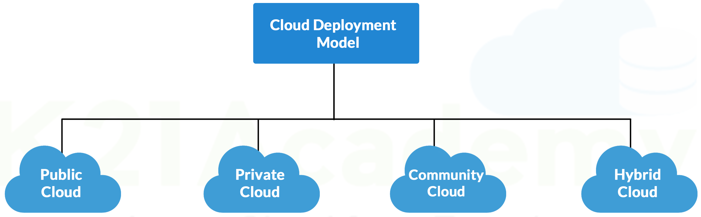
Cloud Deployment Models
Public Cloud
Private Cloud
Hybrid Cloud
Shared infrastructure,
pay-as-you-go.
Dedicated infrastructure, on-premises or hosted.
Mix of public and private, integrated resources.

Slide 7
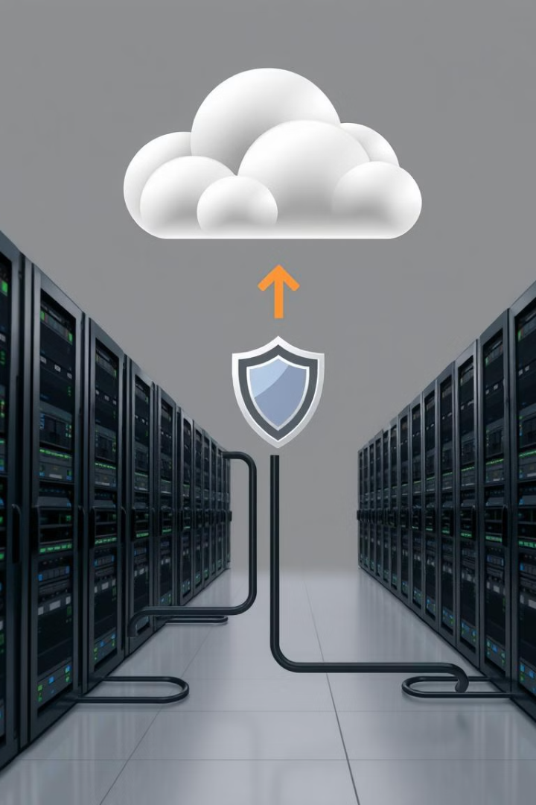



Benefits of Cloud Computing
Cost Savings
Scalability
Reliability
Reduce capital expenditures.
Easily scale resources up or down.
Ensure business continuity.

Slide 8

Security in the Cloud
1
Data Encryption
Protect data at rest and in transit.
2
Access Control
Implement strong authentication.
3
Compliance
Meet regulatory requirements.
4
Incident Response
Plan for security breaches.

Slide 9


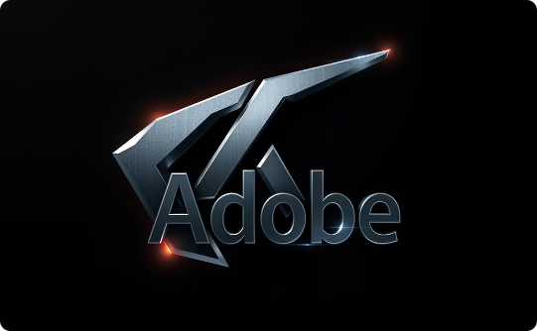

Real-World Examples
Netflix
:Uses AWS for streaming services.
Adobe
:Leverages cloud for creative suite.
Salesforce
:offers CRM via cloud-based platform.

Slide 10



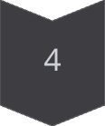

Cloud Computing Trends
Serverless Computing
Focus on functions, not servers.
Edge Computing
Process data closer to the source.
AI and Machine Learning
Power intelligent cloud applications.
Quantum Computing
Super-powered cloud computing.

Slide 11

Thank you
Thank you for attending this presentation.
We hope you found it informative.

